Slide 1
Portfolio Presentation

Slide 2
Presentation Structure
Introduction
Conclusion
Questions?
Showcasing the Portfolio website and talking about PDP
Expected presentation time: 5-10 minutes

Slide 3
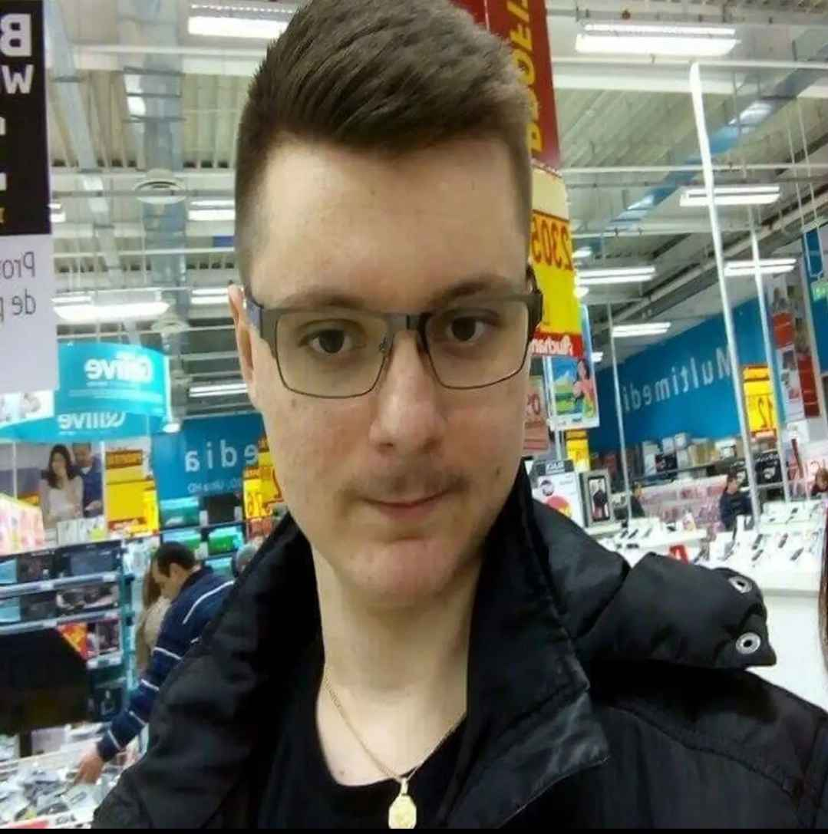
Corodeanu David Cristian
I am a passionate gamer and programmer that is eager to embark on new journeys and conquer challenges ahead.

Slide 4
Let’s go the Portfolio Website!

Slide 5
Conclusion
You have gained more insight into who I am.
This has been a semester packed with interesting experiences and I have greatly developed both my technical and professional skills.
This Portfolio shows some of my biggest accomplishments in
this first half of the scholar year(2025-2026).
Looking forward for the future (exam week vacation)!

Slide 6
Questions?

Slide 7
Thank you

